Slide 1

Interactive Visual Analytics

Slide 2
Objectives
Build an interactive dashboard that contains pie charts and scatter plots to analyze data with the Plotly Dash Python library
Build a dashboard to analyze launch records interactively with Plotly Dash.
Interactive Visual Analytics and Dashboard

Slide 3
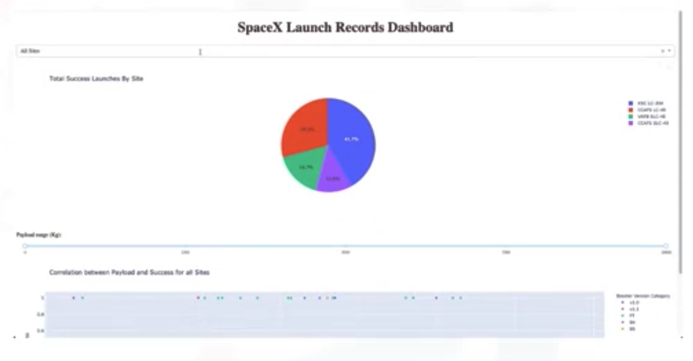
Interactive Visual Analystics
Building a dashboard application with the Python Plotly Dash
  Build a dashboard with dropdown list, range slider, and graphs
  Obtain insights by using the dashboard
Interactive Visual Analytics and Dashboard

Slide 4
Dashboard Application with Plotly Dash
Setup development environment
  Install python packages: python3 -m pip install pandas dash
Download a skeleton dashboard application and dataset
  the SpaceX Launch dataset: wget "https://cf-courses-data.s3.us.cloud-object-storage.appdomain.cloud/IBM-DS0321EN-SkillsNetwork/datasets/spacex_launch_dash.csv"
  skeleton Dash app: wget "https://cf-courses-data.s3.us.cloud-object-storage.appdomain.cloud/IBM-DS0321EN-SkillsNetwork/labs/module_3/spacex_dash_app.py"
Interactive Visual Analytics and Dashboard

Slide 5
TASK 1: Add a Launch Site Drop-down Input Component
Find and complete a commented dcc.Dropdown(id='site-dropdown',...) input with following attributes
  id attribute with value site-dropdownoptions attribute is a list of dict-like option objects (with label and value attributes).
  value attribute with default dropdown value to be ALL meaning all sites are selected
  placeholder attribute to show a text description about this input area, such as Select a Launch Site here
  searchable attribute to be True so we can enter keywords to search launch sites
Interactive Visual Analytics and Dashboard
Notes:
We have four different launch sites and we would like to first see which one has the largest success count.
Need a dropdown menu to let us select different launch sites.

Slide 6
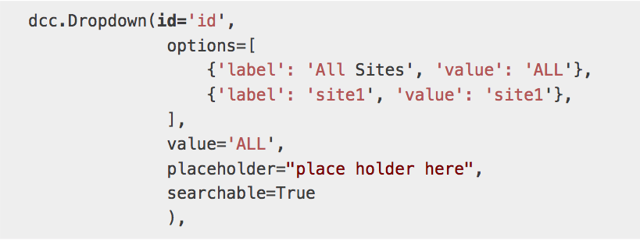

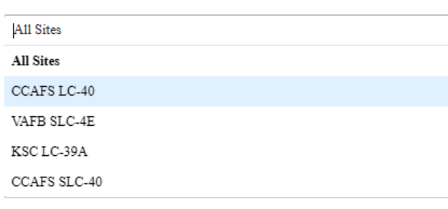
TASK 1: Add a Launch Site Drop-down Input Component
Example of dcc.Dropdown:
The results look like:
Interactive Visual Analytics and Dashboard
Notes:
We have four different launch sites and we would like to first see which one has the largest success count.
Need a dropdown menu to let us select different launch sites.

Slide 7
TASK 2: Add a callback function to render success-pie-chart based on the selected site dropdown
Application logic:
  Input is set to be the site-dropdown dropdown
  Output to be the graph with id success-pie-chart
  A If-Else statement to check if ALL sites were selected or just a specific launch site was selected
    If ALL sites are selected, we will use all rows in the dataframe spacex_df to render and return a pie chart graph to show the total success launches
    If a specific launch site is selected, you need to filter the dataframe spacex_df first in order
Interactive Visual Analytics and Dashboard
Notes:
he general idea of this callback function is to get the selected launch site from site-dropdown and render a pie chart visualizing launch success counts.
Dash callback function is a type of Python function which will be automatically called by Dash whenever receiving an input component updates, such as a click or dropdown selecting event.
If you need to refresh your memory about Plotly Dash callback functions, you may refer to the lab you have learned before:

Slide 8
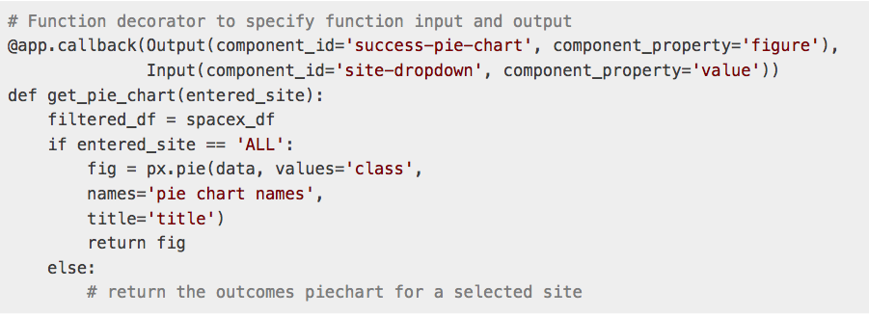
TASK 2: Add a callback function to render success-pie-chart based on the selected site dropdown
Example of a callback function:
Interactive Visual Analytics and Dashboard

Slide 9
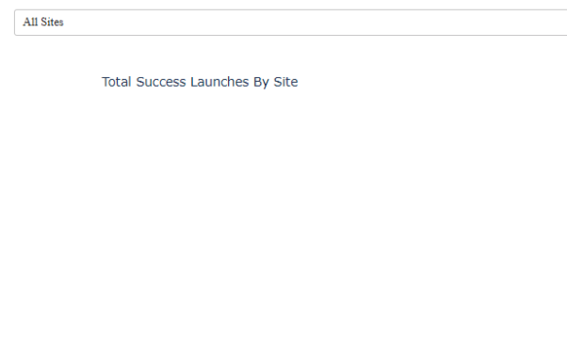
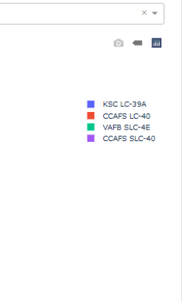
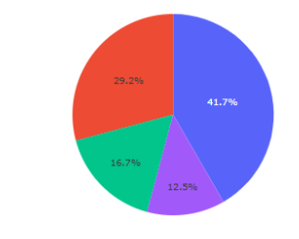
TASK 2: Add a callback function to render success-pie-chart based on the selected site dropdown
The result look like:
  Pie chart for all sites are selected
Interactive Visual Analytics and Dashboard

Slide 10
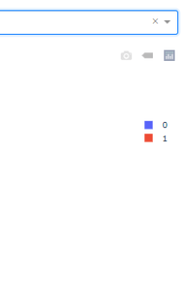
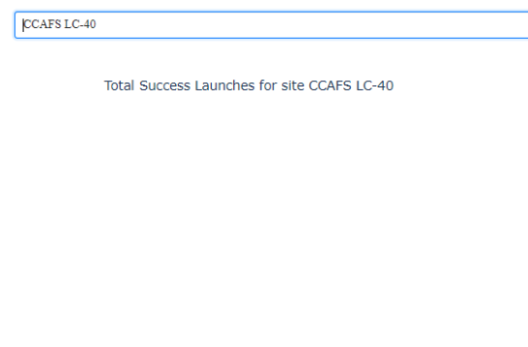
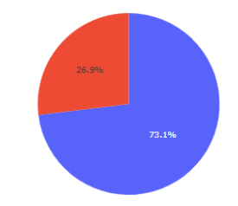
TASK 2: Add a callback function to render success-pie-chart based on the selected site dropdown
The result look like:
  Pie chart for is selected
Interactive Visual Analytics and Dashboard

Slide 11
TASK 3: Add a Range Slider to Select Payload
Find and complete a commented dcc.RangeSlider(id='payload-slider',...) input with the following attribute:
  id to be payload-slider
  min indicating the slider starting point, we set its value to be 0 (Kg)
  max indicating the slider ending point to, we set its value to be 10000 (Kg)
  step indicating the slider interval on the slider, we set its value to be 1000 (Kg)
  value indicating the current selected range, we could set it to be min_payload and max_payload
Interactive Visual Analytics and Dashboard
Notes:
we want to find if variable payload is correlated to mission outcome. From a dashboard point of view, we want to be able to easily select different payload range and see if we can identify some visual patterns.

Slide 12
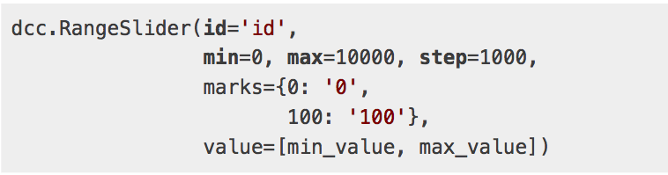
TASK 3: Add a Range Slider to Select Payload
Example of RangeSlider:
Completed payload range slider should be similar
Interactive Visual Analytics and Dashboard

Slide 13
TASK 4: Add a callback function to render the success-payload-scatter-chart scatter plot
Application logic:
  Input to be [Input(component_id='site-dropdown', component_property='value'), Input(component_id="payload-slider", component_property="value")]
  Output to be Output(component_id='success-payload-scatter-chart', component_property='figure’)
Interactive Visual Analytics and Dashboard
Notes:
we want to plot a scatter plot with the x axis to be the payload and the y axis to be the launch outcome (i.e., class column). As such, we can visually observe how payload may be correlated with mission outcomes for selected site(s).
In addition, we want to color-label the Booster version on each scatter point so that we may observe mission outcomes with different boosters.

Slide 14
TASK 4: Add a callback function to render the success-payload-scatter-chart scatter plot
Application logic:
  An If-Else statement to check if ALL sites were selected or just a specific launch site was selected
    If ALL sites are selected, render a scatter plot to display all values for variable Payload Mass (kg) and variable class.
    If a specific launch site is selected, you need to filter the spacex_df first, and render a scatter chart to showvalues Payload Mass (kg) and class for the selected site, and color-label the point using Booster Version Category likewise.
Interactive Visual Analytics and Dashboard
Notes:
we want to plot a scatter plot with the x axis to be the payload and the y axis to be the launch outcome (i.e., class column). As such, we can visually observe how payload may be correlated with mission outcomes for selected site(s).
In addition, we want to color-label the Booster version on each scatter point so that we may observe mission outcomes with different boosters.

Slide 15
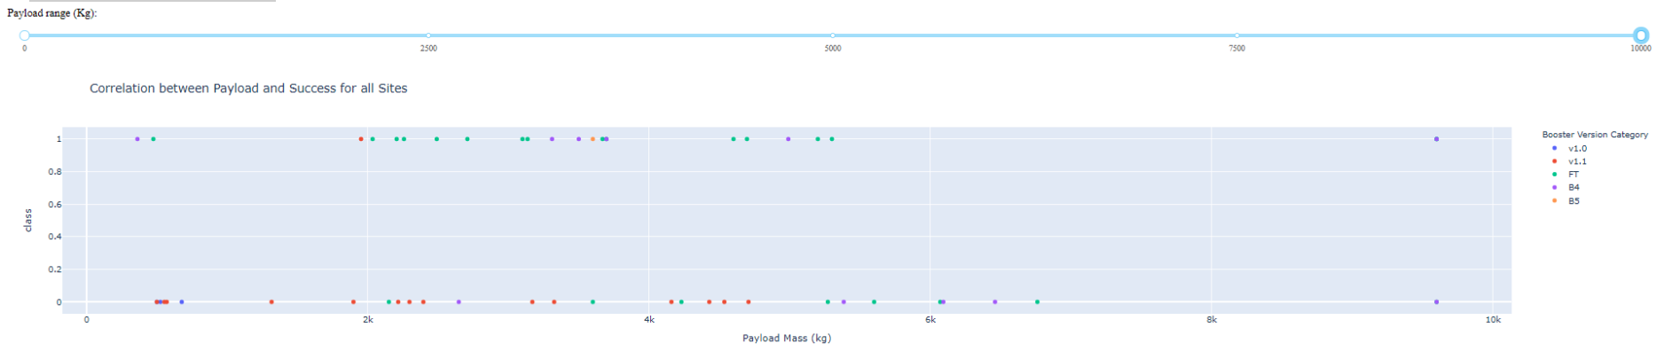
TASK 4: Add a callback function to render the success-payload-scatter-chart scatter plot
Rendered scatter point should look like
Interactive Visual Analytics and Dashboard
Notes:
Which site has the largest successful launches?
Which site has the highest launch success rate?
Which payload range(s) has the highest launch success rate?
Which payload range(s) has the lowest launch success rate?
Which F9 Booster version (v1.0, v1.1, FT, B4, B5, etc.) has the highest
launch success rate?

Slide 16
Plotly Dash Reference
Dropdown (input) component
  Refer here for more details about dcc.Dropdown()
Range slider (input) component
  Refer here for more details about dcc.RangeSlider()
Pie chart (output) component
  Refer here for more details about plotly pie charts
Scatter chart (output) component
  Refer here for more details about plotly scatter charts
Interactive Visual Analytics and Dashboard

Slide 17
Summary
Build an interactive dashboard that contains pie charts and scatter plots to analyze data with the Plotly Dash Python library
Build a dashboard to analyze launch records interactively with Plotly Dash.
Interactive Visual Analytics and Dashboard

Slide 18
Q & A
Interactive Visual Analytics and Dashboard

